Slide 1


Slide 2
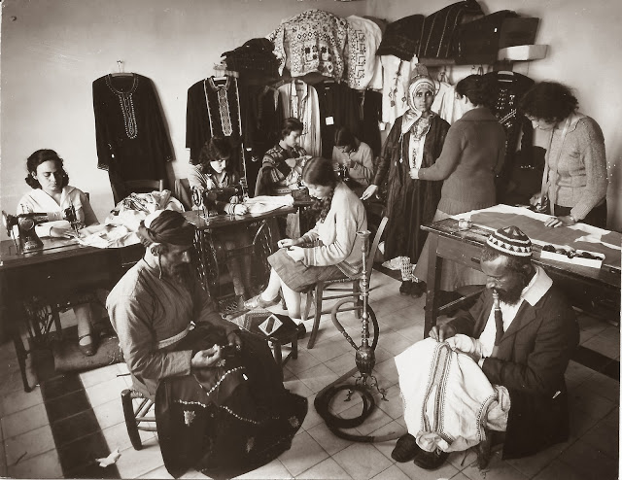



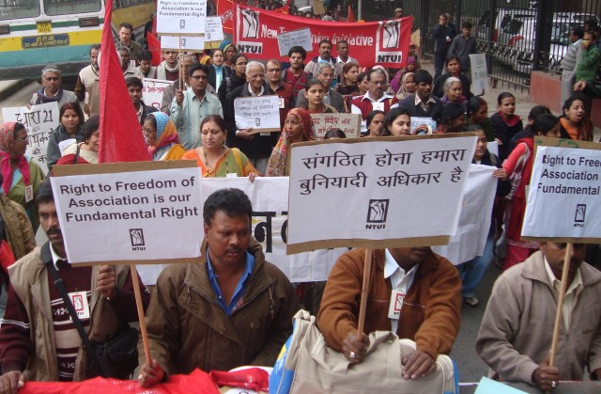
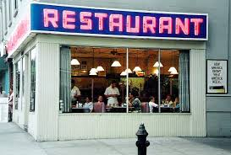
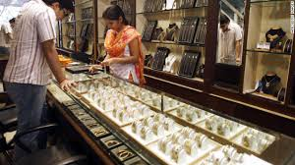

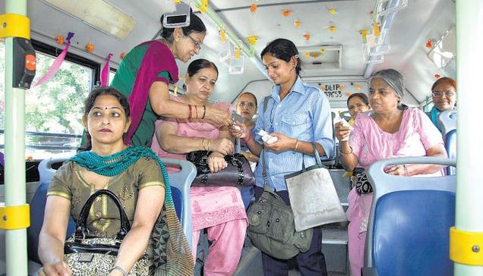
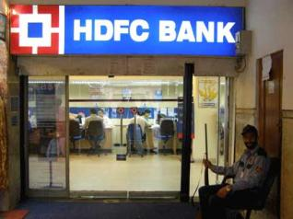

Slide 3
Unit – 1

Slide 4
Introduction
Concept of Law
History and development of mercantile law in India
Scope of the Indian Contract Act, 1872
Sources of mercantile law in India
Codification of the Indian Contract Act, 1872.
Limiting factors of the Indian Contract Act, 1872.

Slide 5

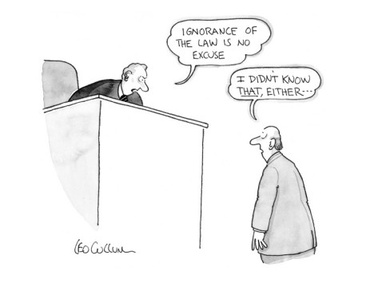
WHAT IS LAW?
A set of rules of conduct recognised & enforced by state
WHY TO KNOW LAW?
“ignorance of law is no excuse”
In Latin - Ignorantia juris non excusat / Ignorantia legis neminem excusat

Slide 6
Concept of Law
Is necessary for the maintenance of peace and order in the society
Woodrow Wilson –
Law is that portion of the established habit and thought of mankind which has gained distinct and formal recognition in the shape of uniform rules, backed by the authority and power of the government.

Slide 7
Legal Environment Significance
Every country is empowered to enact its own laws
They are recognized and enforced by state
They are applied in the administration of justice
Nobody is above law, all are equal before law
‘Rule of Law’: means equality before law – every citizen is subject to ordinary law of the land – the citizen has to face trial in the same courts irrespective of his status or position in the society.

Slide 8
Growth and Development of Judicial System in India
Around 2500 BC in the Indus river valley, first important civilization started developing and continued for 1000 years to be known as Harappa culture.
It is the culmination of thousands of years of settlement.
For Hindus, adherence to virtues and pious/religious practices is Dharma Law.

Slide 9
The Vedas, are still the supreme source of authority for all codes which contained what was then understood as law or dharma
Justice was administered in ancient India according to the rules of civil and criminal law as provided in the Manusmriti (The most important and most studied ancient legal text among the many Dharmasāstras. Manusmriti has some rigid rules which are offending to the women and shudras. Not all Hindus follow Manu Smriti)

Slide 10
The legal system took its colour from the Hindu religious and social practices
Caste system and JHF system predominated in the Hindu Society
The legal system of a country represents the cumulative effect of endeavour, experience, planning and patient labour by many for generations

Slide 11
There was a regular system of local courts from which an appeal lay to the superior court at the capital, and from there to the King in his own court.
In 11th century, Muslims invaded India, so for their administration Muslim law was enforced.

Slide 12
The modern judicial system in India started to take shape with the control of the British in India in 17th Century till 1947.
The present judicial system in India owes much to the judicial system developed during the time of the British.

Slide 13
History and development of mercantile law in India
Business/Mercantile law developed with the changing practices of trade and commerce.
Traders took their disputes to courts.
Judges decided on the basis of the usage and customs of the community and the prevailing notions of reason and justice, also prior judgments.

Slide 14
As similar cases were decided alike, the common reasoning behind them led to the formulation of principles.
The courts, thereafter, followed these principles as law
In several fields, through this process of precedence, a body of principles followed by the judges developed gradually, which came to be called the “common law”.
Contract law was the first business law to emerge. It was a general law dealing with all business transactions. Specialized laws developed on the foundation laid by the contract law.

Slide 15
British India needed law to facilitate trade and commerce in the country.
It borrowed the contract law of Britain and improved upon it. Some of the principles developed by the common law in the previous centuries were out of tune with their times.
The common law a sit was based on the system of precedence of prior judgments, could not discard these.

Slide 16
The law makers of British India, however, had no such compulsions.
Through the process of borrowing and refining, British India got its comprehensive law on contracts, the Indian Contract Act, 1872.
This law is the foundation on which all business relations rest.

Slide 17
The Contract Law
Is mostly commonsense.
Is a dossier of common law prevailing in Britain, prior to 1872. industrial revolution took place.
Through the colonial connection, trade and commerce had become global.
Telegraph and railway were already there.
Despite these advances, as compared to the complex environment of the present day, trade, commerce and specialization in that society can only be described as basic.

Slide 18
Since contract law, as formulated by the judges, was the reason and commonsense of that period, it was readily accessible.
As trade and commerce developed, two developments took place in relation to the principles of common law.
One, the principles came to be applied to newer practices.
Two, several principles came to be applied together, leading to the birth of contract documents.

Slide 19
Understanding the Contract law
Contracts form an inseparable part of our day to day life.
Boarding a bus, buying a soft drink, getting a photocopy made, house rent, electricity bills, telephone, cable, etc and all such everyday activities involve contracts.
Opening a bank account involves a contract, subscribing to a cell phone service.
Building highways, exploration of natural gases… etc

Slide 20
An attempt to learn the contract law by reading the Indian Contract Act, 1872 is illogical.
This will only tell us what the book says, that is, what the law has come to be.

Slide 21

Scope of the Indian Contract Act
The Indian Contract Act was passed and implemented to control various kinds of commercial and business contracts.
The preamble of the Contract Act states where it is expedient to define and amend certain parts of the law relating to contracts.
Therefore, this act is not a complete code of contracts.
It deals with general principles of the Law of Contract and Special Contract

Slide 22
The Contract Act came into force on 1 September 1872.
The act is applicable to the whole of India except for the state of Jammu and Kashmir (because of article 370 of the Indian Constitution)
The law of contract creates jus in personam and not jus in rem.
Jus in personam means personal rights—the rights against a person or a party with whom you have entered into a contract.
Therefore, it can be said that jus in personam provides the right to a contracting party to claim against another

Slide 23
The Contract Act only provides rules and regulations for the purpose of contract.
It does not list any rights and liabilities between parties to the contract.
Rights and liabilities and their manner of performance are decided by the parties themselves under the contract but it is within the purview of the act

Slide 24
Understanding Jus in Rem – Jus in Personam
A sells his car to B for 1 lakh. A has a right to recover the price of the car from B. The right of A is a right in personam, i.e., against a particular person B. This is jus in personam.
B buys a car and becomes the owner of the car. He has a right to have a quiet possession of the car and enjoy it against the whole world. Nobody in the world can disturb him in his right. The right of B is jus in rem, i.e., the right against the whole world.

Slide 25

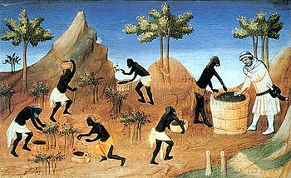
SOURCES
ENGLISH
MERCANTILE INDIAN STATUTE JUDICIAL CUSTOMS &
LAW LAW DECISIONS USAGES

Slide 26
ENG. MERC. LAW -
ENG. LAWS ARE THE PRIMARY SOURCES
AND ARE BASED ON CUSTOMS AND USAGES OF MERCHANTS IN ENGLAND
INDIAN STATUTE LAW –
VARIOUS ACTS LIKE
INDIAN CONTRACT ACT 1872
NEGOTIABLE INSTRUMENTS ACT 1881
ETC

Slide 27
JUDICIAL DECISIONS OF ENG. & INDIAN COURTS –
WHY TO DECIDE ON JD?
BECAUSE, WHENEVER THE LAW IS SILENT ON A POINT THE JUDGE DECIDES ON THE BASIS OF EQUITY, JUSTICE AND GOOD CONSCIENCE.
CUSTOMS & USAGES –
IT GOVERNS THE MERCHANTS OF A TRADE IN THEIR DEALINGS WITH EACH OTHER.

Slide 28
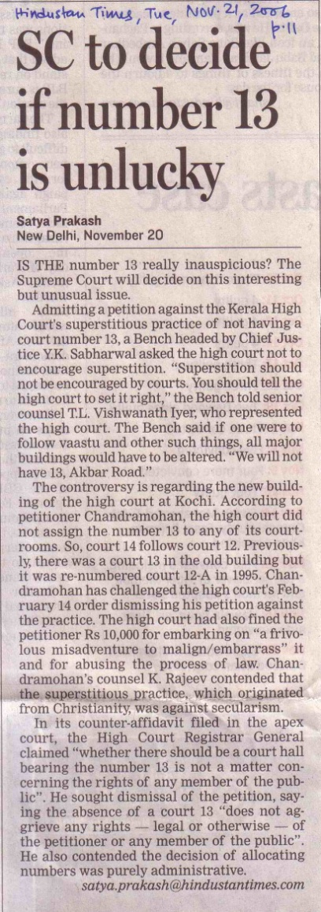
Some interesting facts on Judicial decisions
In a landmark case, Bijoe Emmanuel v State Of Kerala of 1986. Quashing the expulsion of three students belonging to Jehovah's Witnesses from a school for not singing the national anthem, the apex court had held that there is no provision in the law which obliges anyone to sing the national anthem and that not singing the anthem doesn't amount to showing disrespect.
Similar was applicable in Mr. Shashi Tharoor’s case

Slide 29
Indian Contract Act really codifies
[the process of forming a legal code , (i.e. formalizing the laws of a jurisdiction by setting them out in a book of law)]
the way we enter into a contract,
execute a contract,
implement provisions of a contract
and effects of breach of a contract.

Slide 30
The Contract Act consists of limiting factors subject to which
contract may be entered into, executed and breach enforced.
It only provides a framework of rules and regulations which govern formation and performance of contract.
The rights and duties of parties and terms of agreement are decided by the contracting parties themselves.

Slide 31
IT COVERS SPL. PROVISIONS/CONTRACTS
LIKE
BAILMENT
PLEDGE
INDEMNITY
GUARANTEE
AGENCY

Slide 32
CLASSIFICATION & STAGES IN FORMATION OF CONTRACTS
VALIDTY FORMATION PERFORMANCE
Valid Contract
Voidable Contract Express Executed
Void Contract Implied Executory/Bilateral
Illegal Agreement
Void Agreement Quasi contracts Unilateral
Unenforceable Contract

Slide 33
Validity
Valid Contracts – If ‘all the elements of a contract’ are ‘satisfied’.
Voidable Contracts – When one of the elements of a contract named ‘free consent’ is ‘not satisfied’.
Void contract – A valid contract which ceases to be enforceable by law, becomes void when it ceases to be enforceable. When originally entered into is valid & binding on parties, but subsequently becomes void.
Ex: War breaks (becomes and alien enemy), party (ies) lose their competency to continue with the contract (insanity, death, becomes a convict, becomes insolvent, etc).

Slide 34
4. Unenforceable contracts – It is one which cannot be enforced in a court of law. A contract which cannot be enforced is a valid contract in law, but is incapable of proof, and therefore cannot be enforced in the court of law.
Illegal agreements – It is criminal in nature or immoral. All illegal agreements are void. Ex: drugs, kidnapping, murder, etc. Collateral transactions, Ex: 3rd party giving loan knowing that it is for illegal purpose – becomes illegal.
Void agreement ab initio - if one of the parties is ‘not competent’ to enter into a contract. Ex: Minor, Convict, Alien enemy, parda-na-shin women, insolvent, etc.

Slide 35
FORMATION
Express contract:
by words spoken or written
express promise results in express contract
Implied contract:
is inferred from the acts or conduct of the parties
ex- purchase of ticket, boarding a bus at the terminal.
Quasi contract: an obligation created by law regardless of agreement.
“a” a tradesman leaves his goods in anothers house “b”.
“b” treats it as his own.
then “b” is bound to pay for it.

Slide 36
PERFORMANCE
EXECUTED EXECUTORY/BILATERAL UNILATERAL
a contract which is wholly performed by both parties
both the parties are yet to perform
one party is yet to perform

Slide 37
ESSENTIAL REQUIREMENTS OF A VALID CONTRACT
Agreement (Offer and its acceptance)
It should be enforceable by law. Hence, intention should be to create legal relationship. Agreements of social or domestic nature are not contracts
Free consent of both parties
Mutual and lawful consideration for agreement
Parties’ capacity/competency to contract
Object should be lawful
Certainty in meaning
Possibility of performance of contract
Contract should not have been declared as void under Contract Act or any other law
Legal formalities

Slide 38
Definitions
As per section 2(h) of the Indian Contract Act,, “an agreement enforceable by law is a contract.”
As per Sec 2(e) of the Indian Contract Act, “every promise and every set of promises forming the consideration for each other is an agreement”
AGREEMENT = OFFER + ACCEPTANCE
As per Sec 2(b) of the Indian Contract Act, “when the person to whom the proposal is made signifies his assent thereto, the proposal is said to be accepted. A proposal when accepted, becomes a promise”

Slide 39
WHAT IS ENFORCEABILITY OF AGREEMENT
IT HAS TO CREATE LEGAL OBLIGATION
ie., incase of default by either parties, it must be sued.
An intention to sue in a court of law
There is no provision in the Indian Contract Act requiring that an offer or its acceptance should be made with the intention of creating legal relations.
But in English law it is a settled principle that to create a contract there must be a common intention of the parties to enter into legal obligations

Slide 40
Examples for non enforceability of agreement:
Social or domestic agreements {generally no intention to sue}
Invitation to dinner (social)
Balfour vs. Balfour (domestic) Case 1
(– hence no enforceability of such agreements – and no contract)
So, we can say that all contracts are agreements, but not all agreements are contracts

Slide 41
This does not, however, mean that in family or social matters there cannot be a legally binding contract.
All that the law requires is that the parties must intend legal consequences.
McGregor v. McGregor, 1888 Case 2
A binding engagement between a husband and wife. The husband and wife withdrew their complaints under an agreement by which the husband promised to pay her an allowance and the wife to refrain from pledging his credit, the agreement was held to be a binding contract

Slide 42
Objective test of ‘intention’
The test of contractual intention is objective, not subjective. What matters is not what the parties had in mind, but what a reasonable person would think, in the circumstances, their intention to be.
The results of cases on this subject are bound to be variable, for the matter wholly depends upon the fact whether the conduct of the parties in the surrounding circumstances affords evidence of objective intention.

Slide 43
Thus,
In Simpkins v. Pays, 1955 Case – 3.
Where 3 people together, two of them being mother and daughter and 3rd being a guest made entries in a crossword puzzle in the name of the mother, the expenses being met by one or the other without any rules. The entry was successful one week and the mother refused to divide the prize.
The court held,
She was bound to do so, for any reasonable man looking at their conduct would at once conclude that they must have intended to share the prize
In Merrit v. Merrit, 1970 Case – 4.
An agreement to transfer to the wife the beneficial ownership of the matrimonial home made at the time of separation was held to be binding.
In Gould v. Gould, 1970 Case 5.
An agreement was held to be not binding as the husband undertook to pay only as long as he had the means to pay. Uncertainty of these words showed that no legal relations were contemplated.

Slide 44
Even in Business Matters parties may intend to rely on each other’s good faith and honour and not on courts.
Example:
Rose & Frank Co v. J R Crompton, 1925 Case – 6.
An exhaustive agreement was drawn between one American and two English firms for their dealings in paper tissues. The agreement contained the following clause:
‘this arrangement is not entered into as a formal legal agreement and shall not be subject to a legal jurisdiction in the law courts either in the U.S. or in England’
the agreement was terminated by one of the parties contrary to its terms. The American firm brought an action for breach.
It was held that the document did not constitute a binding contract as there was no intention to affect legal relations.

Slide 45
Obligations that does not give rise to contract
Torts or civil wrongs
Quasi-contract
Relation between husband and wife, status obligations (HUF business)
These are not contractual in nature, but enforceable in a court of law

Slide 46
Torts
you would probably take civil action against the grocery store to recoup compensation for pain, suffering, medical bills and expenses incurred as a result of the fall.
torts are a civil action involving private parties, punishment does not include a fine or incarceration. The punishment for tortuous acts usually involves restoring the injured party monetarily. Sometimes a court order may force the tortfeasor to either do or not do something.
Ex:
trespassing, defamation (libel/slander)
Types of torts:
Intentional torts (Battery – hitting someone, Assault – attempting, false imprisonment – confinement without legal authority, etc)
Negligence torts
Strict liability / Absolute liability

Slide 47
An intentional tort is a civil wrong that occurs when the wrongdoer engages in intentional conduct that results in damages to another.
EX: Striking another person in a fight is an intentional act that would be the tort of battery.
EX: Striking a person accidentally would not be an intentional tort since there was not intent to strike the person. This may, however, be a negligent act. Careless conduct that results in damage to another is negligence.
Generally, liability because of a tort only arises where the defendant either intended to cause harm to the plaintiff or in situations where the defendant is negligent.
However, in some areas, liability can arise even when there is no intention to cause harm or negligence.
For example, in most states, when a contractor uses dynamite which causes debris to be thrown onto the land of another and damages the landowner’s house, the landowner may recover damages from the contractor even if the contractor was not negligent and did not intend to cause any harm.
This is called strict liability or absolute liability. Basically, society is saying that the activity is so dangerous to the public that there must be liability. However, society is not going so far as to outlaw the activity.

Slide 48
Rules as to Offer
DEF 2 (a):
“SIGNIFYING TO ANOTHER HIS WILLINGNESS TO DO OR TO ABSTAIN FROM DOING ANYTHING, WITH A VIEW TO OBTAINING THE ASSENT OF THAT OTHER TO SUCH ACT OR ABSTINENCE”
It must fulfill the following three elements:
Must be made by one person to another
Must be an expression of readiness or willingness to do (+ve act or –ve act)
Must be made with a view to obtain the consent of the other person to proposed act or abstinence.
EXPRESS OFFER how to make an offer
IMPLIED OFFER auction (one need not say that in auction u will have a sale, but it is understood)
SPECIFIC OFFER
GENERAL OFFER to whom an offer is made
CARLILL v. CARBOLIC SMOKE BALL COMPANY – an ad in newspaper to use smoke balls – no influenza – if so can claim damages – she claimed - they said acceptance not communicated
Any one who complies with the conditions contained in the General Offer can bind the person who has made the offer.

Slide 49
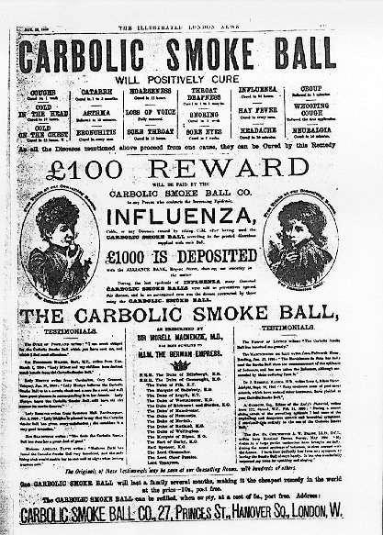

Slide 50
LEGAL RULES AS TO OFFER
must be as in law is capable of being accepted giving rise to legal relationship (the intention must exist with the parties)
terms must be definite, unambiguous, certain and not vague
3. an offer may be distinguished from
i. a declaration of intention (intending to do but has not yet confirmed the act)
declaration: means that an offer will be made or invited in future & not now.
ex:
a declaration announcing in newspaper by auctioneer for sale of furniture.
an auctioneer N advertised that a sale of office furniture would take place at a particular place. M travelled down about 100 km. to attend the sale but found the furniture was with-drawn from the sale. M sued the auctioneer for his loss of time and expenses.
held: N was not liable (Harris v. Nickerson)

Slide 51
ii. invitation to make an offer – (its an offer to make an offer)
an invitation to offer is a party's manifestation (clear appearance) of intention to invite the other party to make an offer thereto.
call for tender (in response to an invitation to offer)
prospectus
display goods by the shopkeeper with prices marked on them – self service system – here the contract starts when the cashier accepts the offer from the customer to buy and receives the price.

Slide 52
LEGAL RULES AS TO OFFER contd….
4. offer must be communicated:
Ex:
A offered to reward the one finds his lost goods.
B without the knowledge of the offer finds it, but he was not entitled for the reward.
5. offer must be made with a view to obtaining the assent and to disclose that intention of making an offer
6. should not contain terms such as
“non compliance of which may be assumed to amount of acceptance”
“if acceptance is not made within a certain time then offer is considered as accepted “
“if no reply…” etc
7. a statement of price is not an offer – Harvey vs. Facey – bumper hall pen

Slide 53
Harvey v. Facey, [1893] AC 552
contract law on the difference between an offer and an invitation. The Judicial Committee held that indication of lowest acceptable price does not constitute an offer to sell.
Rather, it is considered an offer to treat (i.e., to enter into negotiations).
Background
The case was regarding the sale of property.
The respondent L. M. Facey was carrying on negotiations with the Mayor and Council of Kingston for the sale of the property in question.
On the 7th of October 1891, Facey was travelling from Kingston to Porus by train and the appellants caused a telegram to be sent to him saying:
"Will you sell us Bumper Hall Pen? Telegraph lowest cash price-answer paid" Facey replied on the same day:
"Lowest price for Bumper Hall Pen £900." The appellants then replied in the following words: "We agree to buy Bumper Hall Pen for the sum of nine hundred pounds asked by you. Please send us your title deed in order that we may get early possession."
The defendant however refused to sell at that price.
Opinion of the Court
No contract existed between the two parties. The first telegram was simply a request for information, so at no stage did the defendant make a definite offer that could be accepted.

Slide 54
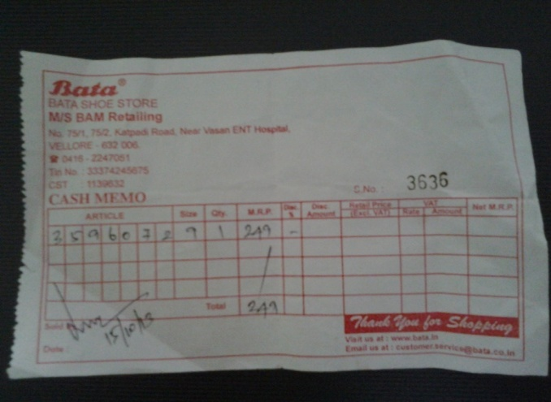
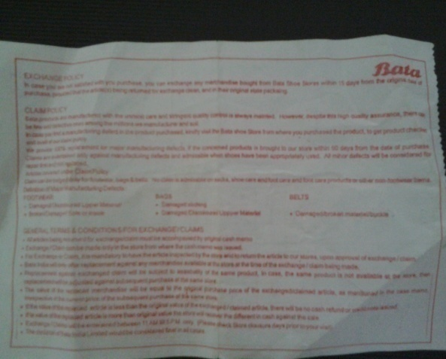
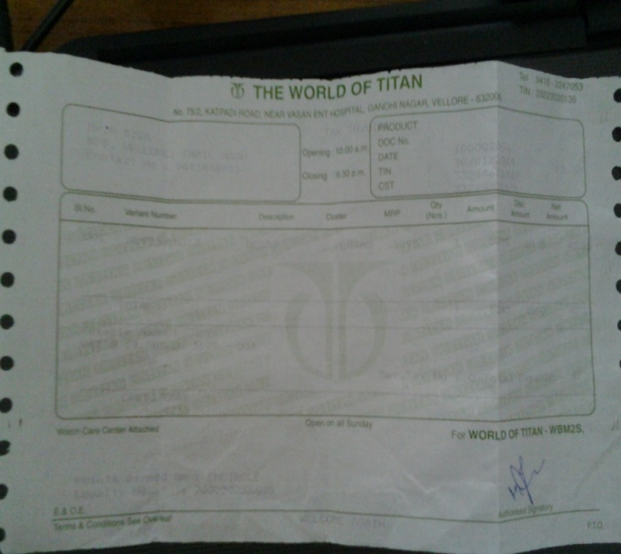
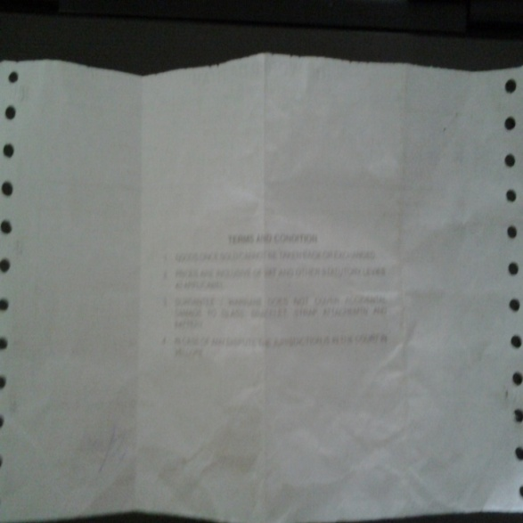
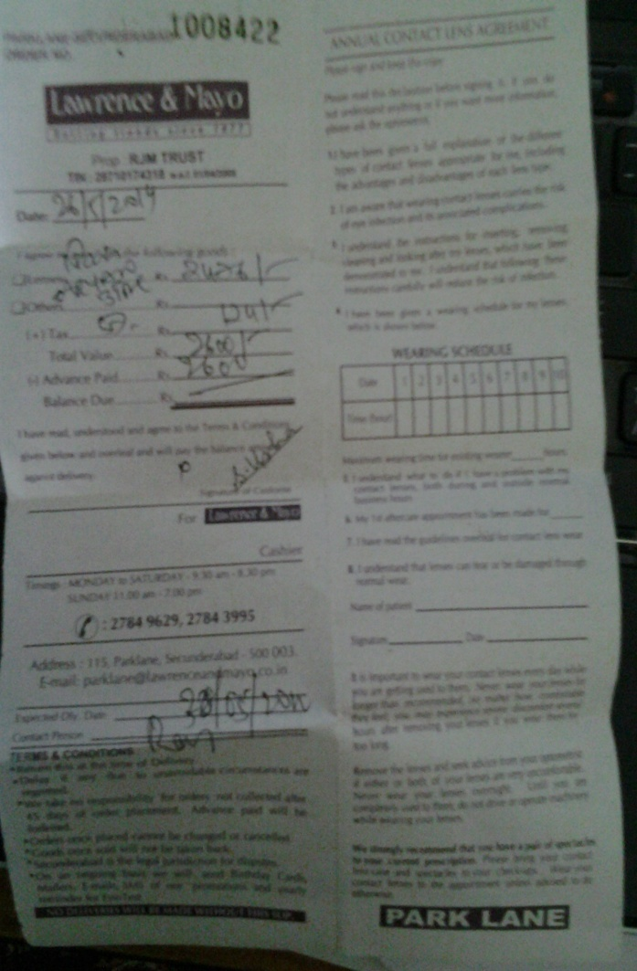
8. Spl. terms in contract must be brought to the notice of the offeree. (generally big companies exploit the weakness of general public by including certain terms which may limit their liabilities, hence.)
ex: notice in hotel bedroom
9. Conditions attached to transactions
ex: for terms see back
10. Cross offer:- in ignorance make similar offers
11. Counter offer:- sell for 1000 – will purchase for 500

Slide 55
ACCEPTANCE
Express and Implied
Who can accept?
Specific: particular person only to whom it is made
General: any one
Rules
absolute and unqualified – it must conform with the offer
communicate to the offeror
mere intention is not enough
a tells b his intension to marry c, but does not tell c. no contract. – sacrament
it must be according to the mode prescribed
must be given within a reasonable time
it should not precede an offer
shares allotted to a person not applied to it – he applies later unaware of the allotment – the earlier is invalid

Slide 56
must show intention by acceptor to fulfill terms of promise
it must be given by the one to whom it is made
it must be given before the offer lapses – discount sale
silence cannot be considered as implied acceptance.
acceptance subject to contract – a formal contract is to be prepared and signed – until then it remains in negotiation stage.
Revocation
- revocation of offer must be made before acceptance.
revocation of acceptance should be made before it reaches the offeror.
Loss of letter of acceptance in postal transit – here the contract is complete – Dunlop vs Higgins

Slide 57
E-contracts

Slide 58
E – CONTRACTS
&
UNCITRAL MODEL LAW
&
IT ACT

Slide 59
Objectives of IT legislation in India
“to provide legal recognition for transactions carried out by means of electronic data interchange and other means of electronic communication, commonly referred to as "electronic commerce", which involve the use of alternatives to paper-based methods of communication and storage of information, to facilitate electronic filing of documents with the Government agencies and further to amend the Indian Penal Code, the Indian Evidence Act, 1872, the Bankers' Books Evidence Act, 1891 and the Reserve Bank of India Act, 1934 and for matters connected therewith or incidental thereto.”

Slide 60
The Act essentially deals with the following issues:
Legal Recognition of Electronic Documents
Legal Recognition of Digital Signatures
Offenses and Contraventions
Justice Dispensation Systems for cyber crimes.

Slide 61
Now we have the ITAA 2008
This Amendment Act got the President assent on 5 Feb 2009 and was made effective from 27 October 2009.
This amendment took place as the earlier act laid more importance on IPC, even as technology has taken a leap, by which time the Mumbai terrorist attack of 26 November 2008 had taken place

Slide 62
Features of the ITAA are as follows
Focussing on data privacy
Focussing on Information Security
Defining cyber café
Making digital signature technology neutral
Defining reasonable security practices to be followed by corporate
Redefining the role of intermediaries
Recognising the role of Indian Computer Emergency Response Team
Inclusion of some additional cyber crimes like child pornography and cyber terrorism
Authorizing an Inspector to investigate cyber offences (as against the DSP earlier)

Slide 63
The UNCITRAL model law
United Nations Commission on International Trade Law
It was formed to facilitate e - commerce and grant legal recognition to
E – contracting
3 important things
Legal recognition to electronic records
Legal recognition to e – sign
Authentication of e – records.
It adopts a technological neutral approach and does not approve or specify any particular form of electronic signature for authentication.
On E – Commerce
Art. 7 recognizes two prime functions of a signature
Identifying the person who is the signer of a document
Verifying that the signer ‘approves the contents’ of that document

Slide 64
Business activities take place based on the contracts formed with T&C
Conventional E-contract
These are two ways of entering into a contract

Slide 65
Defining a contract under Indian Contract Law
“An agreement enforceable in a court of law is a contract”

Slide 66
Formation of offline contracts
It should be enforceable by law. Hence, intention should be to create legal relationship. Agreements of social or domestic in nature are not contracts
There has to be offer and its acceptance
Free consent of parties
Mutual and lawful consideration
Parties’ capacity/competency to contract
Object should be lawful
Certainty and possibility of performance of contract
Contract should not have been declared as void under Contract Act or any other law

Slide 67
E - Contracting
Used generally during internet transactions
When are e - contracts deemed to be formed?
Do they differ from conventional / offline contracts?
Example:-
When will a contract be deemed to be formed?
1. At the time when an acceptance is sent through a click of a mouse
OR
2. When it is actually read by the recipient

Slide 68
They are different for different situations – according to common law
Postal – when communication of letter of acceptance is posted (Dunlop vs Higgins; Bhagwan Dass v Giridhari lal & Co)
In instant forms – only when receipt is generated (ENTORES ltd v Miles Far East Corp.)
Telephone conversation – only when clearly heard (Kanhialal v Dinesh Chandra)

Slide 69
The Indian Approach on E-Contracts
1. Legal Recognition to E contracts under Information Technology Act
Aim of the act –
“to provide for legal recognition for transaction carried out by means of electronic data interchange and other means of electronic communication… which involve use of alternatives to paper based methods of communication and storage information”
(Shaktibhog Foods Ltd v Kola Shipping Ltd)

Slide 70
The Indian Approach on E Contracts
2. Attribution of Electronic Records – Sec. 11 of IT Act
An electronic record is attributed to the originator if it was sent by
the originator himself /
person duly authorized by the originator /
an information system programmed by the originator to send message automatically.

Slide 71
The Indian Approach on E Contracts
3. Acknowledgement of Receipt of Electronic Record - Sec. 12 of IT Act
When the originator has not specified that an acknowledgement of receipt is required in a particular format or method, any means is accepted.
If not received within the specified time, the originator can give notice and treat the record as never been sent.

Slide 72
The Indian Approach on E Contracts
4. Time and place of dispatch and receipt of electronic record – Sec. 13 of IT Act
The dispatch of electronic record occurs - ‘when it enters a computer resource outside the control of the originator’
Receipt of Electronic record –
If provided a designated address, then receipt will be inferred when the e-record enters that address
If not sent to the designated address then the receipt is inferred when retrieved by the addressee
Place of Dispatch
place of business / if more than one place of business, then the principal place of business / in case of absence then residence

Slide 73
Postal rule vs Mail Box Rule
General postal rule is inapplicable and the receipt rule applies to e-mail communication (Article 15 of the UNCITRAL Model Law and Sec 12, 13 of the Indian IT Act, 2000)
In US only the postal rule is followed. Available in sec 15 of UETA** & sec 214 (a) of UCITA*
Reasons –
1. Internet transmission of message is not always error free and can have technical failures, interceptions, disruptions and the intended recipient may not receive or receive delayed communications. This is based on the views of commentators like Dr. Marwan Al Ibrahim, Mr Hisham Tahat
* Uniform Computer Information Transactions Act
** Uniform Electronic transaction Act

Slide 74
Forming an E-contract through website
Four ways
Click wrap
Browse wrap
Shrink wrap
Box wrap

Slide 75
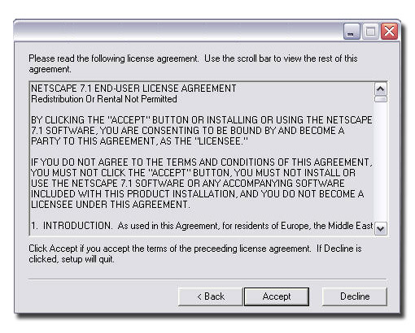
Click wrap
Normally used for downloading software containing provisions to protect IP.
Restraining the licensee from selling the copy
Providing remedies of its choice
I Agree button

Slide 76
Browse wrap
They are online contracts that are held over the internet but aren’t truly clear to the customer.
They are considered “known” agreements where the user automatically agrees to the website’s terms of use contract once they access and use the site.
Browse-wrap (also Browserwrap or browse-wrap license) is a term used in Internet law to refer to a contract or license agreement covering access to or use of materials on a web site or downloadable product. In a browse-wrap agreement, the terms and conditions of use for a website or other downloadable product are posted on the website, typically as a hyperlink at the bottom of the screen

Slide 77
Shrink wraps
They are paper based software license agreements.
Generally attached to the outside box of the software which is covered by plastic shrink wrap
The license agreement is clearly visible and readable through the shrink wrap.
Once an individual breaks the seal of the shrink wrap and opens the box, they essentially agree to the terms and conditions of the software license.

Slide 78
Box wrap
These agreements consist of a product or piece of software that has been shipped to a consumer in a box.
As soon as the consumer receives and opens the box, they will be presented with the company’s license agreement in regards to the software or product.
If the consumer doesn’t agree to the company’s software license agreement, then he has to seal the box back up and ship it back to the company without touching the software / product inside

Slide 79
Validity of wrap agreements
Very much valid, as long as all the essentials are fulfilled, including the essentials of offline contracts.
Till date no cases has been decided in relation to wrap agreements in India.

Slide 80
In USA
Uniform Computer Information Transactions Act (UCITA) contains provisions for click wrap agreements
3 criteria to be satisfied for validity (sec 209 b of UCITA)
The licensee should have reasons to believe that additional terms may be proposed by licensor after the basic agreement is formed.
The licensee must be entitled to return the product at the licensor’s cost
The licensee should be compensated for costs incurred to restore a system in case altered on installing the license terms for review
Manifesting assent (free consent) is applicable for click wrap agreement

Slide 81
Hotmail Corp v Van $ Money Pie
A land mark decision
Hotmail sued its customers for sending spam mails as if the mail was sent from hotmail a/c.
Court held the customers had violated the terms of the contract signed with hotmail
Held click wrap agreement is enforceable in court.

Slide 82
Hubbert vs Dell Corp. Specht vs. Netscape
BROWSE WRAP AGREEMENT CASES
Is the consent manifest (clear/free) in these cases?
Dell – repeated notice to read terms was displayed through hyperlink on Dell website – hence consent manifest
Netscape – the terms were mentioned much below the download button – hence manifest assent was only to download and not to terms

Slide 83
Civil Wrongs under IT Act
Chapter IX of IT Act, Section 43
Whoever without permission of owner of the computer
Secures access (mere U/A access)
Not necessarily through a network
Downloads, copies, extracts any data
Introduces or causes to be introduced any viruses or contaminant
Damages or causes to be damaged any computer resource
Destroy, alter, delete, add, modify or rearrange
Change the format of a file
Disrupts or causes disruption of any computer resource
Preventing normal continuance of computer

Slide 84
Civil Wrongs under IT Act (Contd.)
Denies or causes denial of access by any means
Denial of service attacks
Assists any person to do any thing
Rogue Websites, Search Engines, Insiders providing vulnerabilities
Charges the services availed by a person to the account of another person by tampering or manipulating any computer resource
Credit card frauds, Internet time thefts
Liable to pay damages not exceeding Rs. One crore to the affected party

Slide 85
DEFINITION OF ‘CONSIDERATION’
When, at the desire of the promisor, the promisee or any other person
has done or abstained from doing, or
does or abstains from doing, or
promises to do or to abstain from doing,
something, such act or abstinence is called a consideration for the promise. [section 2(d)].

Slide 86
CONSIDERATION
An agreement without consideration is void.
Need for consideration
it is a remedy to compel the performance of agreement.
LEGAL RULES
1. To support every contract
2. Must move at the desire of the promisor:
Ex: A saves B’s goods from fire without being asked to do so. A cannot demand payment for his services.
3. May move from the promisee or other person:
Ex: ‘A’ gifted her property to ‘B’ directing that she should pay a certain sum of money to ‘C’. ‘B’ then entered into agreement with ‘C’ to pay the amount. Later ‘B’ refused to pay on the plea that no consideration had moved from ‘C’. ‘C’ filed a suit.
This means that even a stranger to the consideration can sue on a contract, provided he is a party to the contract. This is sometimes called as ‘Doctrine of Constructive Consideration’.
Ex: A borrows money from B but fails to return. B is about to file a suit. A agrees to pay higher rate of interest. Hence B does not file suit. This forbearance is also a good consideration.

Slide 87
4. May be past present or future:
– Past: paying for past services:- Eng law its only gratitude or honour
Present: simultaneous and executed
Future: A promises to deliver certain goods after a week. B promises to pay the price after a fortnight.
5. Need not be adequate:
need not be equal in value
6. Must be real and not illusory:
physical impossibility :- putting life into a dead persons body.
legal impossibility :- A owes to B, C asks to pay some money to him, so that he [C] will discharge A from debt.
uncertain consideration :- pay ‘reasonable’ money.
7. It must not be something which the promisor is already legally or contractually bound to do
A promise to pay an advocate additional amount, if the suit was successful. Not a good consideration? – Must render the best services.
But where a person being already under a legal or contractual duty to do something undertakes to do something more than he is bound to do under the original contract – a good consideration – a teacher’s service
8. Not be illegal, immoral

Slide 88
A CONTRACT WITHOUT CONSIDERATION IS VOID – EXCEPTIONS
LOVE AND AFFECTION – consideration not mandatory
COMPENSATION FOR VOLUNTARY SERVICES – consideration not mandatory
PROMISE TO PAY TIME BARRED DEBT
a debt is barred if it is not claimed within 3 yrs of time.
a promise to pay in this regard made in writing is enforceable – consideration not mandatory

Slide 89
GENERAL RULE OF CONTRACT
PRIVITY OF CONTRACT:– Only parties to the contract may sue and be sued.
Example:
- X bought tyres from J & Co.
- sold it to Y a sub dealer.
- Y agreed with X not to sell the same at a lower price than J & Co.’s list price
- if he (Y) sold, then has to pay 5 pounds.
- he(Y) sold and J & Co sued to pay 5 pounds.

Slide 90
EXCEPTIONS TO GENERAL RULE (PRIVITY TO CONTRACT) – STRANGER TO A CONTRACT
A STRANGER TO CONTRACT CAN SUE IF THE CONTRACT IS A:
1. TRUST:
A AGREES TO TRANSFER CERTAIN PROPERTIES TO BE HELD BY B IN TRUST FOR THE BENEFIT OF C. C CAN ENFORCE THE AGREEMENT.
2. MARRIAGE SETTLEMENT, PARTITION, OTHER FAMILY ARRANGEMENTS:
2 BROS ON PARTITION AGREED TO INVEST IN EQUAL SHARES A CERTAIN SUM OF MONEY FOR MOTHER’S MAINTENANCE.
MOTHER ENTITLED TO SUE IF SONS FAILED.
3. ACKNOWLEDGEMENT:
‘A’ RECEIVES MONEY FROM ‘B’ TO PAY IT TO ‘C’.
‘A’ TELLS THIS TO ‘C’.
‘C’ SHALL RECOVER FROM A. – HERE ‘A’ BECOMES AGENT OF ‘C’

Slide 91
Capacity of parties
1ST CATEGORY:
MINORS
GUARDIAN APPOINTED UNDER GUARDIANS & WARDS ACT 1890
1. An agreement is void ab initio with a minor:
Mohiri Bibi vs Dharmodas Gosh
2. he can be a promisee
sale of a house – once entered the promisor cannot avoid the contract.
3. he can be a beneficiary (taking benefits but not responsible for loss)
4. ratification:
consideration under earlier contract- cannot imply when he attains majority age - either fresh contract or continue with the same by ratifying (confirming the old one) it.
5. if minor has received benefit – cannot be asked
6. he can always plead minority – by misrepresenting his age.
7. if the minor is holding the property in specie (actually) – made to restore
etc

Slide 92
2ND Category:
Persons of unsound mind
Sec 12 says
For the purpose of making a contract if at the time when he makes it he is capable of understanding it and of forming a rational judgment as to its effect upon his interests.
Usually sound mind, occasionally unsound – yes
When drunk cannot understand – no
Sound or unsound mind – court decides
Agreements with unsound mind persons – void
Lunatics - mentally deranged due to some mental strain its periodical
Idiots - completely lost his mental powers – void
Drunken - position is similar to lunatic

Slide 93
3rd category:
Other persons
Alien enemies:
During war cannot enter
Contracts made before war
Either suspended or dissolved
In case of ambassadors - take permission from central govt.
Corporations cannot enter into contract of a personal nature
A contract of personal nature or those involving personal skills is such that it needs to be performed by the promisor himself and, therefore, is not assignable.
As contractual capacity is regulated by terms in MOA. – void if

Slide 94
Insolvents- only the official assignee can enter, be sued and sue.
Parda-na-shin woman
Convicts- while undergoing imprisonment cannot. But can when under a license called TOL
Tickets of Leave A Ticket of Leave (TOL) is a document given to convicts when granting them freedom to work and live within a given district of the colony before their sentence expired or they were pardoned. TOL convicts could hire themselves out or be self-employed. They could also acquire property. Attendance was compulsory, as was appearing before a Magistrate when required. Permission was needed before moving to another district and 'passports' were issued to those convicts whose work required regular travel between districts.

Slide 95
FREE CONSENT
The contract is the agreement between two or more persons.
So there must be meeting of minds in similar manner & the meeting must be voluntary.
It must be free from any compulsion or pressure.
A contract without free consent is not proper, but is valid until proved of the inconsistency in the court.
Section 13 of the Indian Contract Act, 1872 says that when two or more persons agree upon the same thing in the same sense, there is consent.
Consent can be express and implied.
Section 14 of the Act goes on saying what is free consent.
There are different elements the presence of which will compel someone to enter into a contract.
So if those elements are present the contract is not formed by free consent

Slide 96
If the following acts take place
Like –
Coercion
Undue influence
Fraud
Misrepresentation
Mistake
Then such contracts are voidable.

Slide 97
Coersion:
In order to cause any person to enter into any contract, one person commits or threatens to commit an illegal act as defined in Indian Penal Code or unlawfully detains any property connected with the other person or threatens to do so.
Ex:
A, on board an English ship on the high seas, causes B to enter into an agreement by an act amounting to criminal intimidation (threat) under the Indian Penal Code. (45 of 1860.) A afterwards sues B for breach of contract at Calcutta.
A has employed coercion, although his act is not an offence by the law of England, and although section 506 of the Indian Penal Code was not in force at the time when or place where the act was done.(45 of 1860.)

Slide 98
UNDUE INFLUENCE:
When a person in a position to dominate the will of other uses this position to obtain an unfair advantage over another in a contract
Ex:
A having advanced money to his son, B during his minority, upon B's coming of age obtains, by misuse of parental influence, a bond from B for a greater amount than the sum due in respect of the advance. A employs undue influence.
A, a man enfeebled by disease or age, is induced, by B's influence over him as his medical attendant, to agree to pay B an unreasonable sum for his professional services. B employs undue influence
A applies to a banker for a loan at a time when there is stringency in the money market. The banker declines to make the loan except at an unusually high rate of interest. A accepts the loan on these terms. This is a transaction in the ordinary course of business, and the contract is not induced by undue influence

Slide 99
FRAUD:
Every act, promise, omission intended to deceive forms fraud
Ex:
A sells, by auction, to B, a horse which A knows to be unsound. A says nothing to B about the horse's unsoundness. This is not fraud in A
But if B says to A - "If you do not deny it, I shall assume that the horse is sound." A says nothing. Here, A's silence is equivalent to speech and amounts to fraud

Slide 100
MISREPRESENTATION:
Misleading another in a contract comes under misrepresentation
Ex:
A is entitled to succeed to an estate at the death of B. B dies. C, having received intelligence of B's death, prevents the intelligence reaching A and thus induces A to sell him his interest in the estate. The sale is voidable at the option of A.

Slide 101
Mistake:
(Sections 20-22)-
Mistake is the erroneous belief either of law or fact by one or other parties or both
Section 20 says that when both parties are under a mistake as to a matter of fact essential to the agreement, the agreement is void

Slide 102
Examples
Classification of Mistake of Law:
Mistake of Indian Law (In sense of penalty): The contract is not voidable because everyone is supposed to know the law of his country. e.g. disobeying traffic rules, etc
Mistake of Foreign Law (void-ab-initio): A mistake of foreign law is treated as mistake of fact, i.e. the contract is void if both the parties are under a mistake as to a foreign law because one cannot be expected to know the law of other country

Slide 103
Mistake of fact Mistake of fact be either Unilateral mistake or Bilateral mistake.
Unilateral mistake [section 22]:
The term 'unilateral mistake' means where only one party to the agreement is under a mistake. According to section 22, "A contract is not voidable merely because it was caused by one of the parties to it being under a mistake as to matter of fact."
Bilateral mistake [section 22]:
The term 'bilateral mistake' means where both the parties to the agreement are under a mistake. According to section 20, "where both the parties to an agreement are under a mistake as to a matter of fact essential to the agreement, the agreement is void." thus, the following conditions must be satisfied before declaring a contract void under this section:
1. Both the parties must be under a mistake
2. Mistake must be of fact but not of law.
Ex: Mistake about price is valid

Slide 104
Legality of object
Void agreement
If forbidden by law- eg., a promise to give employment in public service on paying 1 lkh
Nature is such that it would defeat the provisions of law- eg: evade tax
Fraudulent- A an agent of B giving on lease B’s property to C, without B’s knowledge
causes injury to the person or property of another- injury = wrong, harm, damage
A borrows 1000 from B. executes a bond to work without pay for 2 yrs & in case of default will pay a very high rate of interest will the principal amt at once.
Immoral-
A pays B and asks to divorce her husband C. then marry A.
illegal-
purchasing prohibited goods from alien country
Agreement to commit crime
opposed to public policy-
When harmful to public welfare- agreement to pay a public servant to act corruptly.

Slide 105
Wagering Agreement-
Literally the word ‘wager’ means ‘a bet’ something stated to be lost or won on the result of a doubtful issue, and, therefore, wagering agreements are nothing but ordinary betting agreements. Thus where A and B mutually agree that if it rains today A will pay B Tk.100 and if it does not rain B will pay A Tk.100 or C and D entered into agreement that on tossing up a coin, if it fall head upwards C will pay D Tk.50 and if falls tail upwards D will pay C Tk.50, there is a wagering agreement. In Tracker vs. Hardy Cotton, L.J., described a ‘wager’ ad follows: “The essence of gaming and wagering is that one party is to win and the other to lose upon a future event which at the time of the contract is of an uncertain nature- that is to say, if the event turns out the other way he will win.” Agreement by way of wager, void. Section 30 lays down that
“agreements by way of wager are void; and no suit shall be brought for recovering anything alleged to be won on any wager, or entrusted to any person to abide the result of any game or other uncertain event on which any wager is made,”

Slide 106
Thus, where A and B enter into an agreement which provides that if England’s cricket team wins the match, A will pay B Rs. 100, and if it loses B will pay Rs. 100 to A, nothing can be recovered by the winning party under the agreement, it being a wager.
Similarly, whether C and D enter into a wagering agreement and each deposits Rs.100 with Z instructing him to pay or give the total sum to the winner, no suit can be brought by the winner for recovering the bet amount from Z, the stake-holder. Further, if Z had paid the sum to the winner, the looser cannot bring a suit, for recovering his Rs.100, either against the winner or against, the stake-holder, even if Z had paid after the loser’s definite instructions not to pay. Of course the looser can recover back his deposit if he makes the demand before the stake-holder had paid it over to the winner (Ratnakalli vs. Vochalapu). But even such a deposit cannot be recovered by a loser in the States of Maharashtra and Gujarat where such an agreement is void and illegal.

Slide 107
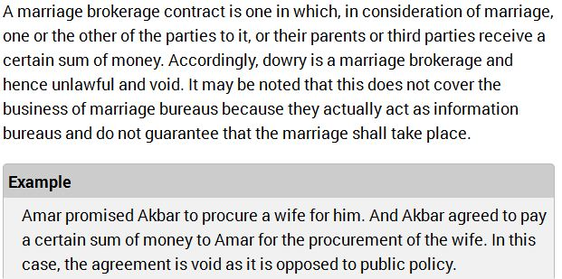
Marriage Brokerage Contracts
Are void = agreement for the sale of a girl (Kanyasulkam ; dowry)

Slide 108
?
A promises B to pay 1 lakh of rupees, if C son of B marries D.
Upon completion of marriage, A fails to pay B. Can B recover on the ground of breach of contract?

Slide 109
Answer
Inter caste marriage arrangements have been held to be valid.
* Amirchand v. Ram Rattanchand, Punjab.

Slide 110
Performance of contract
Offer to perform/ attempted performance/ tender
As tender would amount to complete performance, if the offer were carried out, the requisites of a valid tender are indicated by the requisites of valid performance.
Requisites
There must be an un-conditional offer to perform, coupled with a manifested/clear ability to carry out the offer, and a production of the subject-matter of the tender
eg., amt due will be paid on condition that certain shares shall be sold at cost- not valid tender
the amount tendered must not be less than what is due; and if greater, there must be no demand for a return of the excess.
The medium of payment must be that which the contract specifies or in the absence of contractual definition that which the law has made legal tender;
the time must be that fixed by the contract or by law;
it must not be before maturity;
and the hour of the day must be reasonable.
But at the present time in case of a liquidated debt a valid tender may be made subsequent to the day of maturity by adding legal interest to the amount of the debt

Slide 111
Discharge of contract
Termination of contractual relations between the parties to contract
A contract is said to be discharged when the rights and obligations of parties under the contract come to an end
MODES OF DISCHARGE OF CONTRACT
1. Actual performance
2. Attempted performance
3. Mutual consent- altering, novation, etc
4. Operation of law - insolvency, unauthorised material alteration
5. Impossibility of performance- destruction of subject matter, death, supervening impossibility (personal incapacity, etc)
6. Discharge by lapse of time- debt 3yrs, immovable property 12yrs
7. Discharge by breach of contract

Slide 112
1. Actual performance:
When a party to a contract does what he had undertaken to do under the contract, he is said to have actually performed his obligation to the contract. Then it becomes the duty of the other party to do what he had agreed to do under the contract. Thus, when both the parties perform their respective obligations, the contract comes to an end.
Contracts usually indicate when, where and how the performance is to be done. It must be done strictly according to the terms and conditions of the contract.

Slide 113
2. Attempted performance / offer to perform / tender:
Sometimes, the party who is bound to perform a promise under a contract is ready and willing to perform it at the proper time and place, but is unable to do so because the other party does not accept the performance. This willingness of the party is known as ‘Attempted performance’ or ‘Offer to perform’ or ‘Tender’.
Thus, tender may be defined as “an offer to perform the obligation under the contract in accordance with the terms of the contract. It is not actual performance.”

Slide 114
Types of Tender:
Tender or attempted performance is of two types, viz. –
1. Tender of Goods, i.e., attempted performance of a promise to do something, and
2. Tender of Money, i.e., attempted performance of a promise to pay something.

Slide 115
Essentials of a Valid Tender:
Under Section 38, a tender, to be valid and adequate, must have the following essentials:-
1. It must be unconditional,
2. It must be for the whole quantity, contracted for or for the whole obligation. It must not be in installments, if the contract requires it in full.
3. It must be by a person who is in a position and is willing to perform the promise.
4. It must be at the proper time and place. A tender of goods after the business hours or of the goods or money before the due date will not be valid.
5. It must be in proper form.
6. It must be made to a proper person, i.e., the promisee or his authorised agent.
7. The promisee must be given a reasonable opportunity to inspect the goods.
8. It may be made to one of the several joint promises.

Slide 116
3. By mutual consent (alteration / novation / remission)
Alteration – change certainT&C in original contract
Novation – replace the whole contract with a new one (same parties / different parties)
Remission – accepting a lesser sum than what was contracted for / a lesser fulfilment of the promise made

Slide 117
Subsequent or Supervening impossibility
Case: Taylor vs. Caldwell
A music hall was agreed to be let out for a series of concerts, the hall was burnt

Slide 118
7. Breach (actual or anticipatory)
AB occurs when a party repudiates it before the time fixed for performance has arrived / when a party by his own act disables himself from performing the contract.
Ex: A contracts to supply B with certain articles on 1st January. On 28th December he informs B that he will not be able to supply the goods. B is entitled to sue A for breach.

Slide 119
Actual breach –
at the time when performance is due / during the performance of the contract
Ex: A seller offers to execute a deed of sale only on payment by the buyer of a sum higher than is payable under the contract for sale, the vendor shall be liable for the breach

Slide 120
Remedies for Breach of Contract
Recession of contract
Suit for damages
Suit upon quantum meruit
Suit for injunction
Suit for specific performance

Slide 121
REMEDIES FOR BREACH
I. RESCISSION OF CONTRACT
the other party fails – may rescind- file a suit to rescind
When a breach of contract is committed by one party, the other party may sue to treat the contract as rescinded. In such a case, the aggrieved party is freed from all his obligations under the contract.
II. SUIT FOR DAMAGES
monetary compensation
SUIT UPON QUANTUM MERUIT
Quantum meruit is a judicial doctrine that allows a party to recover losses (As much as he has deserved) in the absence of an agreement or binding contract
When a person employs another to do work for him, without any agreement as to his compensation, the law implies a promise from, the employer to the workman that he will pay him for his services, as much as he may deserve or merit.

Slide 122
For instance, most professional roofers hired to repair a roof insist on having a formal agreement with the owner of the house before beginning the repairs.
In the absence of an agreement or formal contract, the roofer may be unable to recover losses in court if the transaction goes awry.

Slide 123
allows to recover the value of labor and materials,
prevents the Unjust Enrichment of the other party.
Quantum meruit can be used to address situations where no contract exists or where a contract exists but for some reason is unenforceable.
In such cases courts imply a contract to avoid an unjust result. Such contracts are called quasi contracts.
Quantum meruit also describes a method used to determine the exact amount owed to a person.
A court may measure this amount either by determining how much the defendant has benefited from the transaction or by determining how much the plaintiff has spent in materials and services.

Slide 124
IV. SUIT FOR AN INJUNCTION
An injunction is an order of the court requiring a person to perform a negative obligation.
Injunctions fall into two broad categories:
Prohibitory injunction, which is an order that something must not be done.
Mandatory injunction, which is an order that something must be done, for
example to pull down a wall which has been erected in breach of contract.
Like specific performance it is an equitable remedy and the court exercises its discretion according to the same principles as with specific performance,
eg,
Page One Records Ltd v Britton and Warner Brothers v Nelson.

Slide 125
V. SUIT FOR SPECIFIC PERFORMANCE
This is an order of the court requiring performance of a positive contractual obligation.
"Specific performance" is a specialized remedy used by courts when no other remedy (such as money) will adequately compensate the other party.
If a legal remedy will put the injured party in the position he or she would have enjoyed had the contract been fully performed, then the court will use that option instead.
The most common reason courts grant specific performance is that the subject of the contract is unique.
When a contract is for the sale of a unique property, mere money damages will not remedy the purchaser's situation

Slide 126
Example: R offers to buy B's house and B accepts, but later decides to keep the property. Real estate is considered to be unique. Since there is no other piece of property or house exactly like B's, R may be entitled to specific performance on the contract. B would be compelled to go through with the sale.
Performance of marriage when promised – the victims respect etc may be hurt/ injured
Courts will enforce specific performance only if the underlying contract was fair and equitable. Other commodities that courts have found to support specific performance include works of art, custom-made products, and goods in short supply.

Slide 127
Specific performance is not available in the following circumstances:
Damages provide an adequate remedy.
Where the order could cause undue hardship.
Where the contract is of such a nature that constant supervision by the court would be required, eg, Ryan v Mutual Tontine Association.
Where an order of specific performance would be possible against one party to the contract, but not the other.
Where the party seeking the order has acted unfairly or unconscionably. He is barred by the maxim ‘He who comes to Equity must come with clean hands’.
Where the order is not sought promptly the claimant will be barred by the maxims ‘Delay defeats the Equities’ and ‘Equity assists the vigilant but not the indolent’.
In general the court will only grant specific performance where it would be just and equitable to do so.

